Slide 1
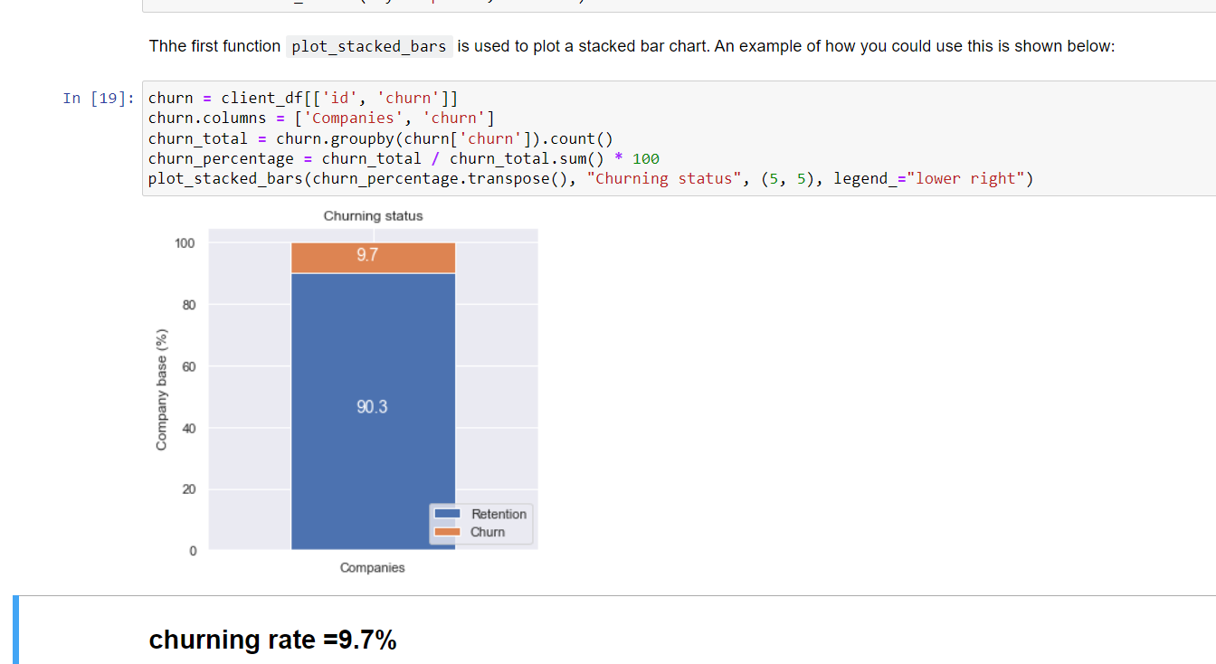
Sub_Task 3
Key findings
1. About 9.72% of customers changed providers.
2. Changes in prices does not affect customer churn.
Suggestions
1. Competitor price data – If other providers can gave a much better offer than the current provider, customers were more likely to transfer to new provider even if their current prices dropped.
3. Other possible factors, such as customer satisfaction.
For example, if providers could keep providing excellent customer services, it is very likely a rise in prices will not lead to customer churn.

